Slide 1
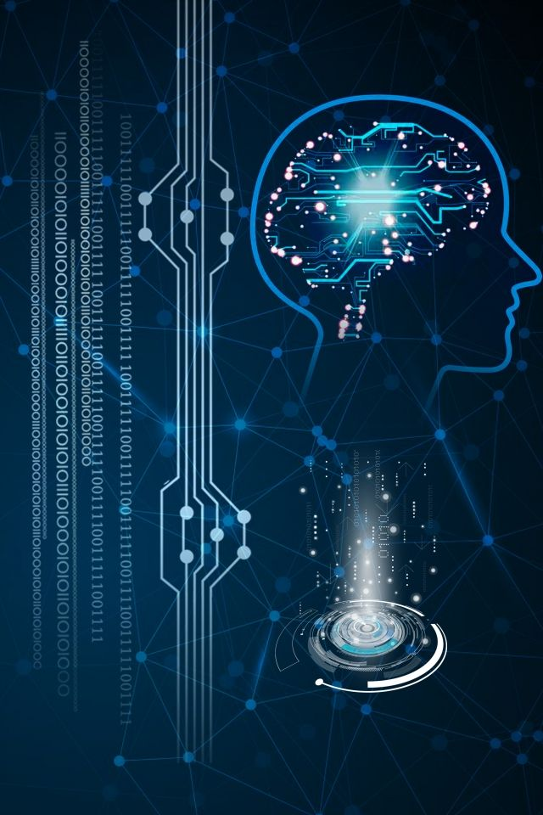

Introduction to Deep Learning and Neural Network
Deep learning is a powerful machine learning technique that has revolutionized the field of artificial intelligence. By using complex neural networks, deep learning models can learn to recognize patterns and make predictions from large datasets, enabling them to tackle a wide range of tasks with unprecedented accuracy.

Slide 2
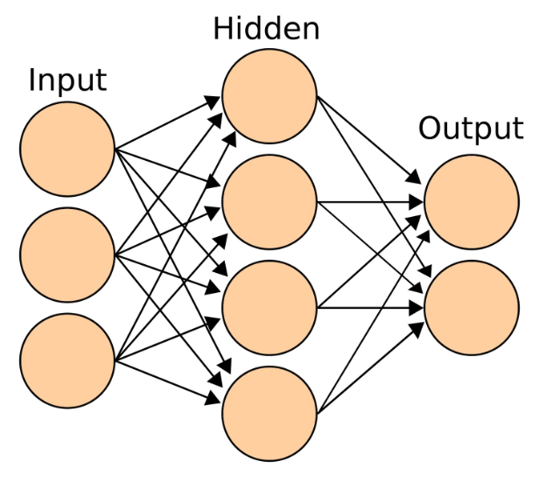
What is Deep Learning?
Deep learning is a powerful machine learning technique that uses artificial neural networks to learn and make predictions from large amounts of data. It can tackle complex problems that were once considered difficult for computers to solve.
Deep learning models are trained on massive datasets, allowing them to discover intricate patterns and extract meaningful features automatically. This makes deep learning exceptionally well-suited for tasks like image recognition, natural language processing, and predictive analytics.

Slide 3
The Power of Neural Networks
Adaptability
1
Neural networks can learn and adapt to complex patterns in data.
Nonlinearity
2
They can model nonlinear relationships that traditional methods struggle with.
Scalability
3
Neural networks can process massive amounts of data and scale to large problems.
Neural networks are a powerful machine learning technique inspired by the human brain. They can uncover hidden patterns, make accurate predictions, and solve complex problems that traditional algorithms struggle with. This adaptability, nonlinearity, and scalability is what makes neural networks so transformative across many industries.

Slide 4
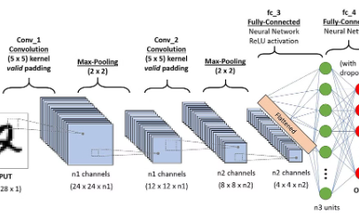
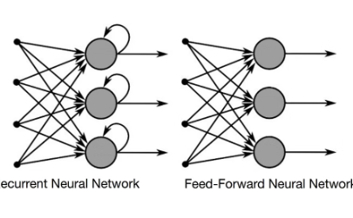
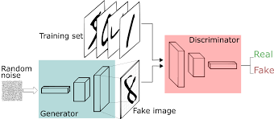

Types of Neural Networks
Convolutional Neural Networks
Recurrent Neural Networks
Generative Adversarial Networks
Designed for processing grid-like data, such as images, these networks excel at image recognition and classification tasks.
Adept at processing sequential data, like text or speech, these networks can retain information from previous inputs to make predictions.
These powerful networks pit two neural nets against each other, allowing them to generate realistic new data like images or audio.

Slide 5
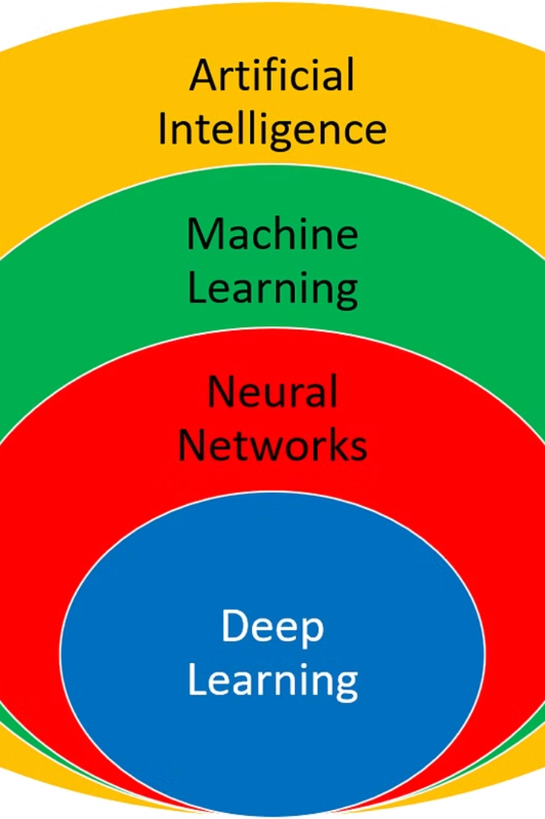
Applications of Deep Learning
Deep learning has revolutionized numerous industries, from computer vision and natural language processing to drug discovery and autonomous vehicles. Its ability to learn complex patterns in data has enabled breakthroughs in fields ranging from healthcare to entertainment.
For example, deep learning algorithms can analyze medical images to detect diseases, assist in robot navigation, and even generate realistic artwork and music. The versatility of deep learning makes it a powerful tool for solving a wide variety of real-world problems.

Slide 6




Training Neural Networks
Data Preparation
Gather and preprocess your training data, ensuring it is clean, balanced, and representative of the problem you're trying to solve.
Architectural Design
Choose the appropriate neural network architecture, considering factors like input/output dimensions, depth, and complexity based on your task.
Hyperparameter Tuning
Experiment with hyperparameters like learning rate, batch size, and regularization to optimize the network's performance on your validation set.
Training Process
Train the network using the backpropagation algorithm, monitoring for convergence and making adjustments to improve accuracy.

Slide 7
Deep Learning Frameworks
TensorFlow
PyTorch
Keras
Caffe
TensorFlow is an open-source machine learning framework developed by Google. It provides a flexible ecosystem of tools, libraries, and community resources that enable researchers to push the state-of-the-art in ML and developers to easily build and deploy ML-powered applications.
PyTorch is an open-source machine learning library based on the Torch library, used for applications such as computer vision and natural language processing. It features a tape-based auto-grad system and dynamic neural networks.
Keras is a high-level neural networks API that runs on top of TensorFlow. It provides an easy-to-use interface for building and training deep learning models, with support for both convolutional networks and recurrent networks.
Caffe is a deep learning framework developed by the Berkeley Vision and Learning Center. It is known for its modularity, speed, and expression, making it a popular choice for researchers and developers working on computer vision problems.

Slide 8
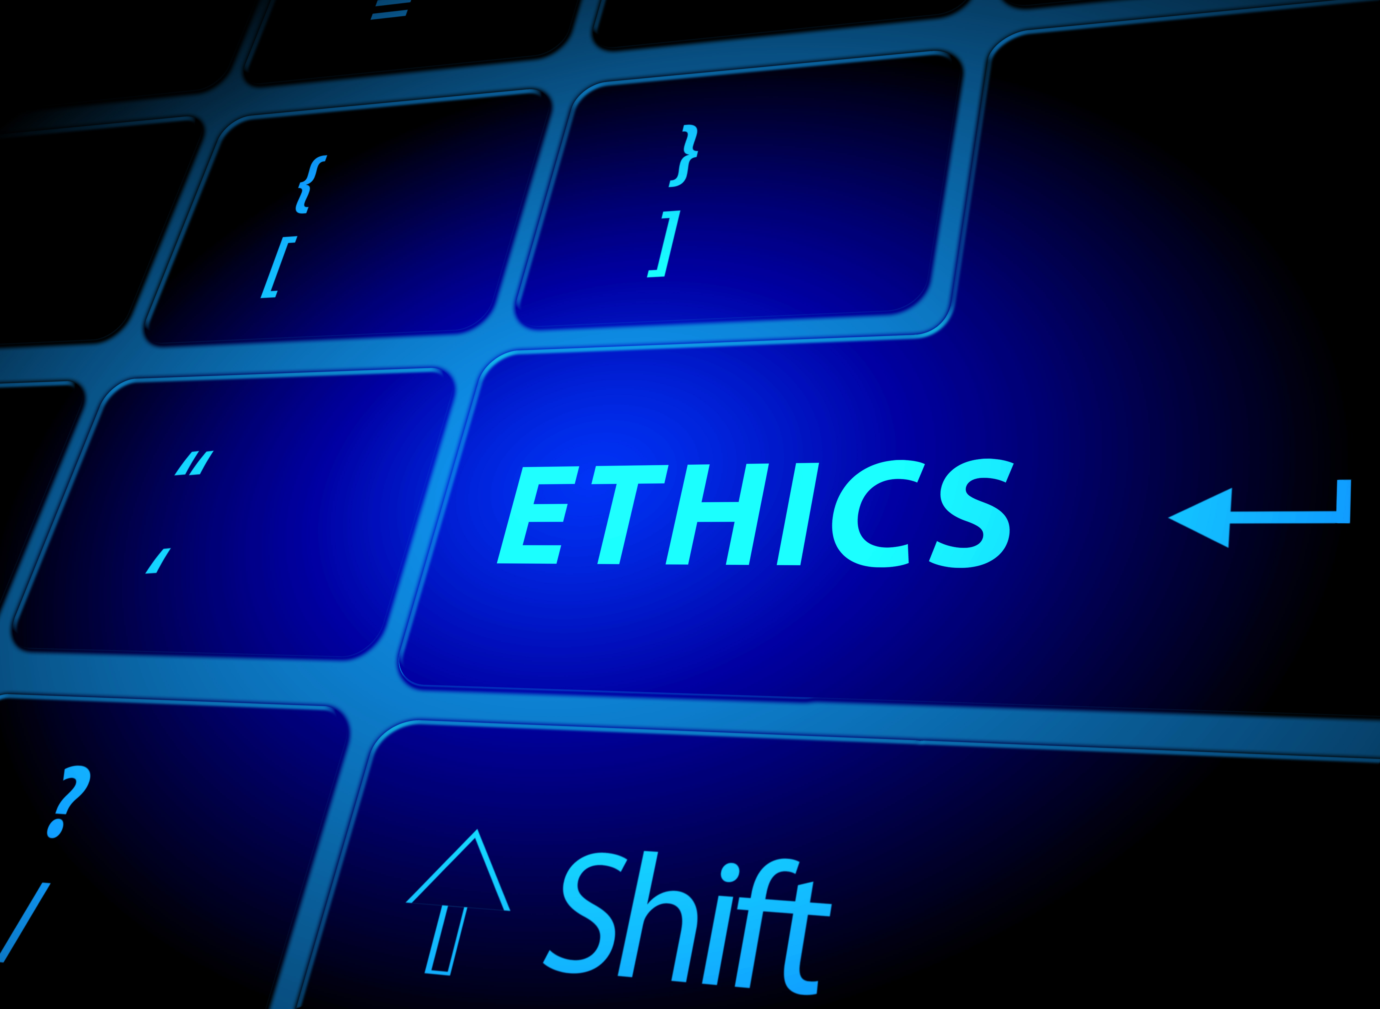
Challenges and Ethical Considerations
As deep learning systems become more powerful and ubiquitous, there are growing concerns about the potential risks and ethical implications. Bias and fairness issues can arise from biased training data or algorithms, leading to discrimination. Privacy and data security are also major challenges as deep learning models require vast amounts of personal data. Additionally, the transparency and interpretability of deep learning models can be problematic, making it difficult to understand and explain their decision-making processes.

Slide 9
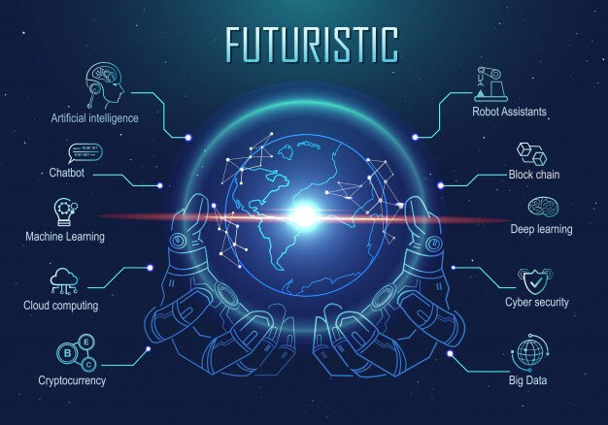
The Future of Deep Learning
As deep learning continues to advance, the future holds immense potential. Innovations in areas like generative AI, transfer learning, and neuromorphic computing will push the boundaries of what's possible. Deeper integration with edge devices and real-time decision-making will enable new breakthroughs across industries.
The rise of explainable AI and ethical AI will be crucial as deep learning systems become more powerful and influential. Continued advancements in hardware, algorithms, and data will unlock even greater capabilities, transforming how we interact with technology and solve complex problems.

Slide 10

Thank You

